Slide 1

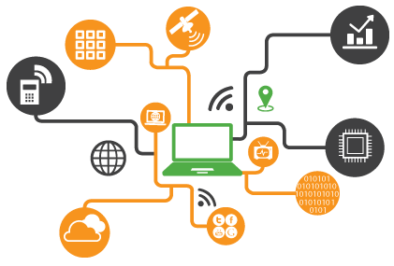
IOT based Weather Monitoring System
By
N. Jaya Simha Reddy

Slide 2
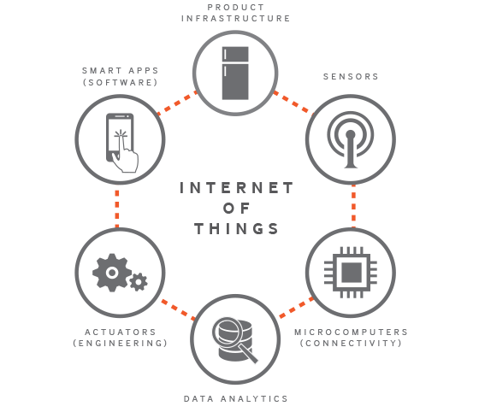
What exactly is IOT?
IoT is short for Internet of Things. The Internet of Things refers to the ever-growing network of physical objects that feature an IP address for internet connectivity, and the communication that occurs between these objects and other Internet-enabled devices and systems.

Slide 3
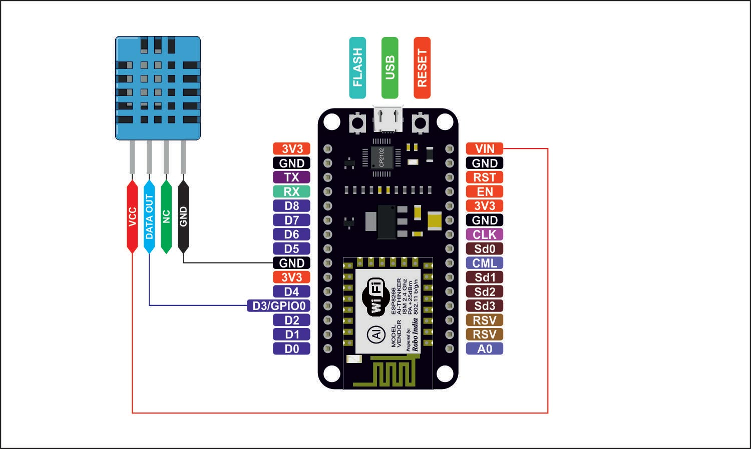
Components Used
Node MCU DHT 11

Slide 4
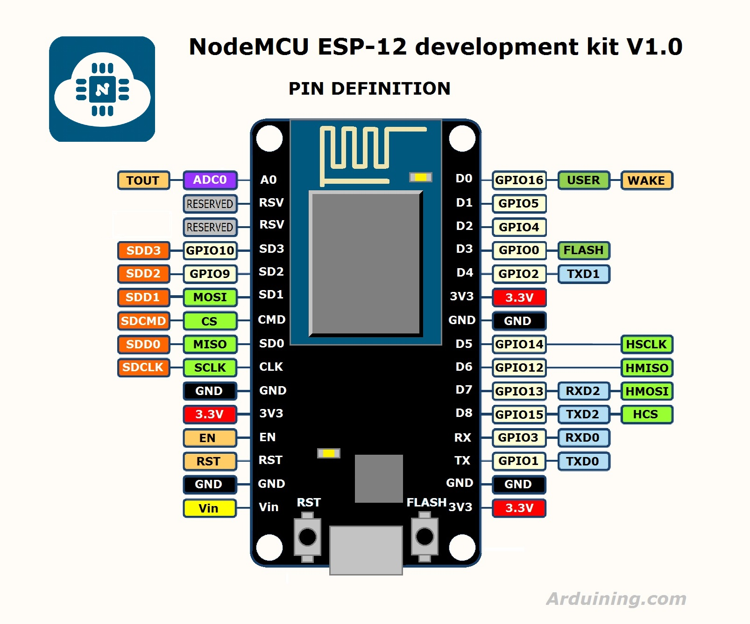

Slide 5
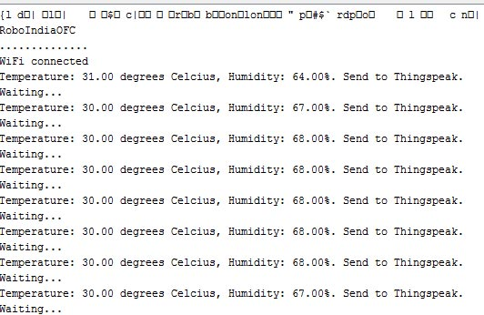
We send the data to Things Board server

Slide 6
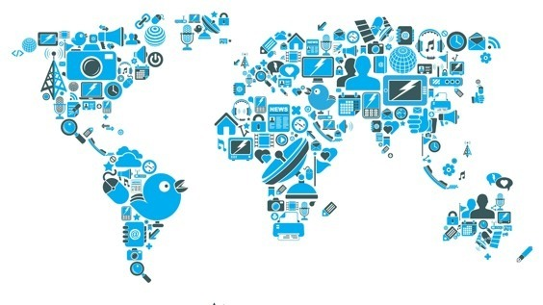
Thank You

